Slide 1
PERSONAL INVESTMENT STRATEGY
Traditionally INDIANS invested in:
Bank Deposits.
Gold and
Public Provident Fund
Some wrongly bought Insurance Polices thinking them to be investment rather than protection.
Those who could afford, in addition to these financial instruments also bought real estate.
TRADITIONAL INVESTMENT
PRODUCTS DESTROY WEALTH IN REAL TERMS
The question is: HOW?

Slide 2
INFLATION
How INFLATION affects Prices and Returns
Assume:
You want to buy a product today for Rs.100 and the Rate of Inflation is 5%
After a year the same product costs you Rs. 105
After a year, Rs.100 in your SB account @ 3.5% interest will fetch you Rs.103.50
If you want to buy the same product (Rs.100 last year) you must have Rs.105
You have Rs.103.5 with you. You have to arrange for extra RS.1.5 to buy it
SO, BY KEEPING YOUR MONEY IN SB ACCOUNT, WHICH GIVES YOU A RATE OF INTERST LESS THAN THAT OF INFLATION, YOU HAVE DESTROYED YOUR REAL WEALTH BY RS.1.5
If your interest income is more than Rs.10,000/- per year, you will also pay tax on that@10%- bringing down the interest received to Rs.3.15
YOUR POST-TAX RETURN SHOULD BE MORE THAN THE RATE OF INFLATION.

Slide 3
LONG TERM RETURNS
Creating a large wealth in 2,3, or 5 years is very difficult
Creating large wealth in 15,20 or 25 years, by investing in equities and good equity mutual funds is not that difficult.
Consider the following fact:
  In the last 25 years, the sensex has given a return of 9%
  Gold 8.9%
  Fixed Deposit 8.7%
  Good Equity Mutual Fund 12.2%
Return on FD and Gold are taxable.
Returns from Equity and Equity Funds is Totally TAX FREE
By investing Rs. 10,000 per month through SYSTEMATIC INVESTMENT PLAN (SIP) for 25 years, you will have a portfolio of rs.1.9 crores. If the same amount is invested in RD, you will get Rs.69.7 lakhs.

Slide 4
WHAT IS SIP AND HOW DOES IT WORK?
People invest sporadically and stop investing when Stock Markets fall.
Falling stock market or stock prices is projected as a CRISIS in media.
This makes no sense.
Systematic Investment Plan (SIP) explains this problem.
SIP means investing a fixed sum regularly(once started, goes on and on)
Investment is made in units calculated on NAV (net asset value)
The NAV of a mutual fund has not been correctly understood by a large section of the investing community.

Slide 5
NAV
Definition of NAV. Net Asset Value, or NAV, is the sum total of the market value of all the shares held in the portfolio including cash, less the liabilities, divided by the total number of units outstanding. Thus, NAV of a mutual fund unit is nothing but the 'book value.
This is the price at which investors buy ("bid price") fund shares from a fund company and sell them ("redemption price") to a fund company.
Outstanding shares refer to a company's stock currently held by all its shareholders, including share blocks held by institutional investors and restricted shares owned by the company's officers and insiders.

Slide 6
“Float” is the number of shares that are actually available for trading when you subtract restricted shares. In short, float is the amount of stock that is practically available for trading.
A: The term "float" refers to the regular shares that a company has issued to the public that are available for investors to trade. This figure is derived by taking a company's outstanding shares and subtracting from it any restricted stock.

Slide 7
WHAT IS SIP AND HOW DOES IT WORK?...Cont.
Definition of NAV
Net Asset Value, or NAV, is the sum total value of all the shares held in the portfolio including cash, less the liabilities, divided by the total number of units outstanding. Thus, NAV of a mutual fund unit is nothing but the 'book value.'
NAV vs Price of an equity share
In case of companies, the price of its share is 'as quoted on the stock exchange,' which apart from the fundamentals, is also dependent on the perception of the company's future performance and the demand-supply scenario. And hence the market price is generally different from its book value.
There is no concept as market value for the MF unit. Therefore, when we buy MF units at NAV, we are buying at book value. And since we are buying at book value, we are paying the right price of the assets whether it be Rs.10 or Rs.100. There is no such thing as a higher or lower price.

Slide 8
NAV and its impact on the returns
We feel that a MF with lower NAV will give better returns. This again is due to the wrong perception about NAV. An example will make it clear that returns are independent of the NAV.
Say, you have Rs 10,000 to invest. You have two options, wherein the funds are same as far as the portfolio is concerned. But say one Fund X has an NAV of Rs 10 and another Fund Y has NAV of Rs 50. You will get 1000 units of Fund X or 200 units of Fund Y.
After one year, both funds would have grown equally as their portfolio is same, say by 25%. Then NAV after one year would be Rs 12.50 for Fund X and Rs 62.50 for Fund Y. The value of your investment would be 1000*12.50 = Rs 12,500 for Fund X and 200*62.5 = Rs 12,500 for Fund Y. Thus your returns would be same irrespective of the NAV.
It is quality of fund, which would make a difference to your returns. In fact for equity shares also broadly this logic would apply.

Slide 9
NAV and its impact on the returns....continued
An IT company share at, say, Rs 1,000 may give a better return than say a jute company share at Rs 50, since IT sector would show a much higher growth rate than jute industry (of course Rs 1000 may 'fundamentally' be over or under priced, which will not be the case with MF NAV).
Mutual Funds are investment options wherein the money from several investors is pooled in by an Asset Management Company (AMC) and invested in different instruments such as debt, equity, securities and money market.
The resulting profit, after deductions by the AMC, are divided among the investors as per their portfolios. Mutual funds are regulated by the Association of Mutual Funds in India (AMFI).

Slide 10
TYPES OF MUTUAL FUNDS
Equity: Also known as growth funds, these invest exclusively in the stocks of domestic companies listed on the stock exchanges. These are categorized as high-risk funds.
Money market: These are mainly meant for investors looking at short-term profits and easy liquidity. These funds are invested in money market instruments such as Treasury bills (T-Bills), Commercial Papers (CPs), Repurchase Agreements (Repo) and government securities. These are categorised as low-risk funds.
Debt: These are also called income funds and provide fixed returns by investing exclusively in low-risk fixed income securities. Debt funds are typically low-risk funds.
Hybrid or balanced: These funds invest in both fixed income securities (debt) and stocks (equities), thereby offering a balanced portfolio to investors.
Mutual funds are also hyphenated on the basis of closed or open loop structures.
Close-ended: These funds have fixed maturities and cannot be easily withdrawn or closed before maturity.
Open-ended: You can withdraw the investment at any point of time and get refunds within a week. More and more mutual funds are offering open-ended fund options nowadays.

Slide 11
Costs associated with investing in mutual funds
How to invest in mutual funds?
It is critical for investors to understand the type of fees and charges associated with buying and redeeming mutual fund shares. These fees have a dramatic impact on the performance of an investment in the fund. They also vary widely by the specific fund.
The fund value is calculated as per the Net Asset Value (NAV), which is the net of expenses on every unit of the fund. This is calculated after every business day by the AMC.
AMCs will charge you an annual fee, which covers their salaries, brokerage, advertising and administrative expenses. As a thumb rule, the larger the fund size, the less will be the annual fee.
AMCs may also charge loads, which are basically sales charges incurred by the company in the form of distribution costs.

Slide 12
How to invest in mutual funds?
Asset allocation
The first thing here is to understand what kind of portfolio you want.
This is known as asset allocation. The ideal asset allocation route
would help you to invest in a number of funds that reflect your risk
profile and cover the asset classes that align with your future requirements.
Your asset allocation should have a healthy mixture of high risk and low risk components.
In general, the percentage of funds you allocate to low risk debt instruments should be equal to your age. For instance, if you are a 30 year old, then 30% of your fund allocation should go toward debt instruments.
This will cushion you against any downturns in the remaining assets that you have invested in. A golden rule here is that the younger you are, the more you can invest in equities and other high risk mutual funds.
Up to a certain age, your risk profile should be moderately high as you have certain flexibilities to invest in high-return funds without getting too worried out potential losses.

Slide 13
Short listing fund types
Next step is to look and compare different mutual funds on the basis of their past performance and investment philosophy. For this, you should refer to the shareholder reports and prospectuses provided by AMCs. The prospectus will detail the information related to the mutual fund from a legal perspective while the shareholder report can help you figure out past performance and consistency of returns.
Next, what’s the time limit for returns that you are comfortable with? Some mutual funds are open-ended while others are close-ended. In case of the latter, you won’t be able to liquidate the funds until the fund has matured. Therefore, you need to be careful about the time frame you’re investing for.
In general, the shorter the period of investment, the less should be the risk profile, while a higher time frame will help you in overcoming downturns from high return and high risk instruments, if any.

Slide 14
Comparing funds
Once you have factored in the points given above, you should be able to shortlist funds. Some other tips for picking the right funds are:
When looking for a mutual fund, check its past history by checking performance online.
Look for the top 5 funds in the asset class that matches with your financial goals, time frame and risk profile.
Check performance of the funds in different periods such as 3 months, 6 months, 1 year, 2 years and so on.
The funds that feature in all of these lists denote all-round performance and are most likely managed by exceptional fund managers.
Check for the profile of fund managers and asset allocators. This can be found in the prospectus of the respective mutual funds.
The decision you take here will help you in coming to an informed decision that covers all the corners of your financial decision-making process. Though exhaustive, you need to do all this to ensure that you are taking the right decision,

Slide 15
Following up
So you have selected funds and have asked for forms and documents to fill and submit. Your job’s done, right? No, following up on your investments is equally important. Any savvy investor will tell you the importance of keeping track of the funds you’ve invested in, even if the funds are managed by top notch advisors and managers. And if you have invested in open-ended funds, this can increase your flexibility and help you maximize profits and minimize downturns or traps. The following means will help you track the performance of your investments:
Online: The website for your mutual fund or an aggregating website will give daily updates on the performance of funds. These can be tracked through daily NAVs, performance stats, newsletters, fact sheets etc. In addition, the AMFI website also contains historical and daily data on NAVs of funds.
Newsletters: Newsletters are typically released on a quarterly basis by the concerned AMC. This will have information on portfolio as well as a direct report coming from the respective fund manager detailing performance and other variables.
Newspapers: Financial newspapers also publish NAVs as well as sale prices of various schemes apart from reports and fact sheets.
All this data can seem overwhelming, but unless you have an over-diversified portfolio, you can manage the reviewing task pretty easily. All the information can be accessed online and you can always fall back on a mobile app that gives you updates about your mutual funds. This will only take minutes of your time daily and can help you manage investments better.

Slide 16
How much should I invest
Assumptions: Retirement at 60 years Life Expectancy 85 years Inflation 7% Expected post-retirement Returns 8% on corpus
Investment | SIP(Rs. Pm) | Expected Return | Expected Corpus
NPS | 5000 | 10% | Rs.84 lakhs
ELSS | 5000 | 12% | Rs.1.21 crores
Multi cap Fund | 4000 | 12% | Rs.97 lakhs
Total | 14000 |  | 3.02 crores
Child Education | 3400 (18 years) | 12% | 28 lakhs
Marriage | 5000 (20 years) | 12.5% | 26.47 lakhs

Slide 17
HOW TO SAVE RS.1 CRORE FOR YOUR TETIREMENT?(60 years)
25 YEARS | 30 YEARS | 35 YEARS | 40 YEARS | 45 years
Rs. 1815 | Rs.3246 | Rs.5875 | Rs.10,871 | Rs.20,017
The BSE market segment definition is too complicated for the average investor, you can simply follow the US market cap limit definitions in dollar terms and translate them to our currency. If we translate US market cap definitions to Indian Rupees,
Companies with more than Rs 10,000 crores of market cap are large cap companies.
Companies with market caps between Rs 500 to 10,000 crores are mid cap companies.
Companies with market cap of less than Rs 500 crores are small cap companies.

Slide 18
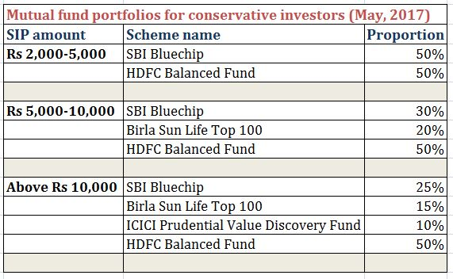

Slide 19
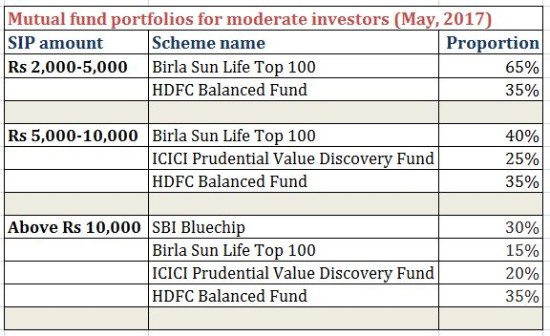

Slide 20
